Slide 1

Introduction of Pandas and visualization
By,
Pratik Parate

Slide 2

What is Pandas?
[pandas] is derived from the term "panel data", an econometrics term for data sets that include observations over multiple time periods for the same individuals.
Pandas is an open-source python library that is used for data manipulation and analysis. It provides many functions and methods to speed up the data analysis process.
The pandas package is the most important tool at the disposal of Data Scientists and Analysts working in Python today.
The powerful machine learning and glamorous visualization tools may get all the attention, but pandas is the backbone of most data projects.

Slide 3

What’s pandas for?
Through pandas, you get acquainted with your data by cleaning, transforming, and analyzing it.

Slide 4

What's Pandas for? Cont..
If want to explore a dataset stored in a CSV on your computer. Pandas will extract the data from that CSV into a DataFrame — a table, basically — then let you do things like:
Calculate statistics and answer questions about the data, like
*What's the average, median, max, or min of each column?
*Does column A correlate with column B?
*What does the distribution of data in column C look like?
Clean the data by doing things like removing missing values and filtering rows or columns by some criteria
Visualize the data with help from Matplotlib. Plot bars, lines, histograms, bubbles, and more.
Store the cleaned, transformed data back into a CSV, other file or database

Slide 5
How does pandas fit into the data science toolkit?
Not only is the pandas library a central component of the data science toolkit but it is used in conjunction with other libraries in that collection.
Pandas is built on top of the NumPy package, meaning a lot of the structure of NumPy is used or replicated in Pandas. Data in pandas is often used to feed statistical analysis in SciPy, plotting functions from Matplotlib, and machine learning algorithms in Scikit-learn.
Jupyter Notebooks offer a good environment for using pandas to do data exploration and modeling, but pandas can also be used in text editors just as easily.
Jupyter Notebooks give us the ability to execute code in a particular cell as opposed to running the entire file. This saves a lot of time when working with large datasets and complex transformations. Notebooks also provide an easy way to visualize pandas’ DataFrames and plots.

Slide 6
Pandas- Install and import
Pandas is an easy package to install. Open up your terminal program (for Mac users) or command line (for PC users) and install it using either of the following commands: conda install pandas OR
pip install pandas
Alternatively, if you're currently viewing this article in a Jupyter notebook you can run this cell:
!pip install pandas
The ! at the beginning runs cells as if they were in a terminal.
To import pandas we usually import it with a shorter name since it's used so much:
import pandas as pd

Slide 7
Core components of pandas:
The primary two components of pandas are the Series and DataFrame.
A Series is essentially a column, and a DataFrame is a multi-dimensional table made up of a collection of Series.
DataFrames and Series are quite similar in that many operations that you can do with one you can do with the other, such as filling in null values and calculating the mean.

Slide 8
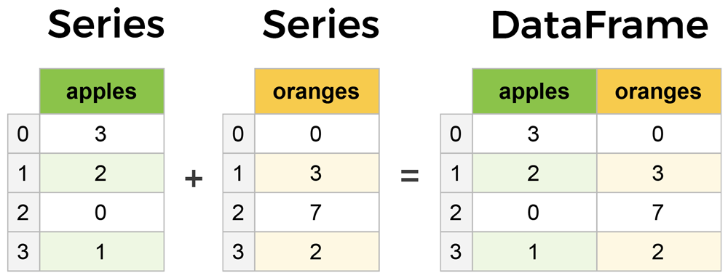
Example for Series and DataFrame:

Slide 9

Creating DataFrames from scratch
Creating DataFrames right in Python is good to know and quite useful when testing new methods and functions you find in the pandas docs.
There are many ways to create a DataFrame from scratch, but a great option is to just use a simple dict.

Slide 10
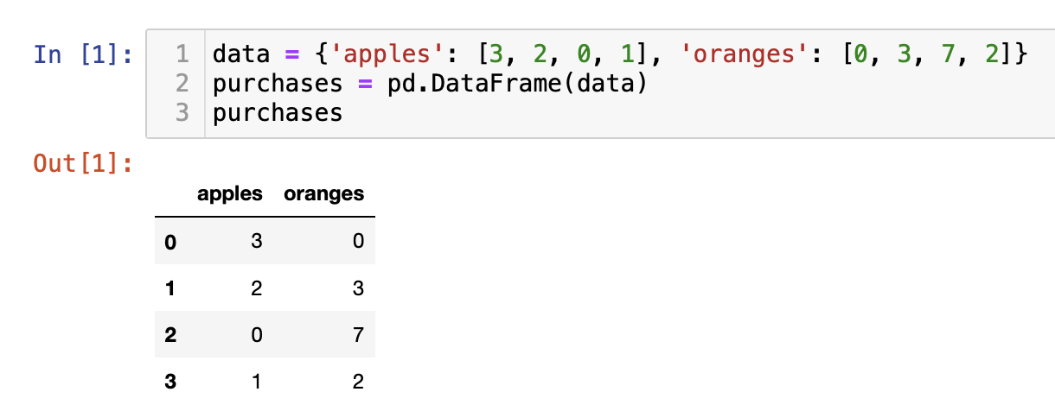
Eg. For Creating DataFrame
If we have a fruit stand that sells apples and oranges. We want to have a column for each fruit and a row for each customer purchase. To organize this as a dictionary for pandas we could do something like:
And then pass it to the pandas DataFrame constructor:

Slide 11
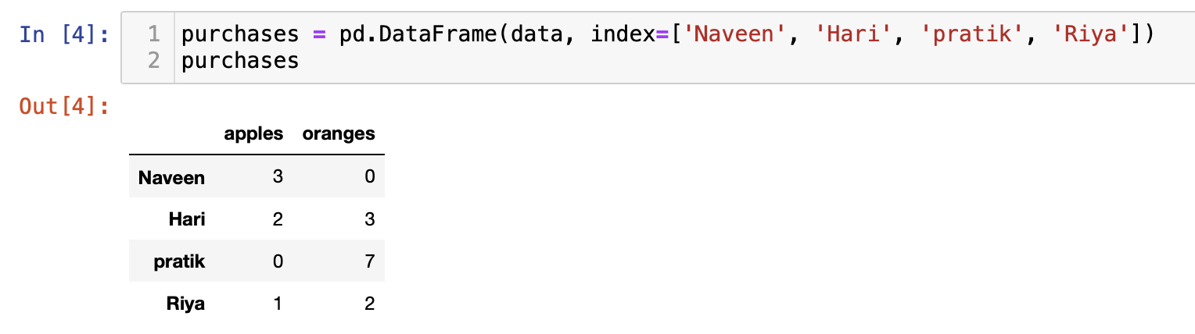
How did that work?
Each (key, value) item in data corresponds to a column in the resulting DataFrame.
The Index of this DataFrame was given to us on creation as the numbers 0-3, but we could also create our own when we initialize the DataFrame.

Slide 12
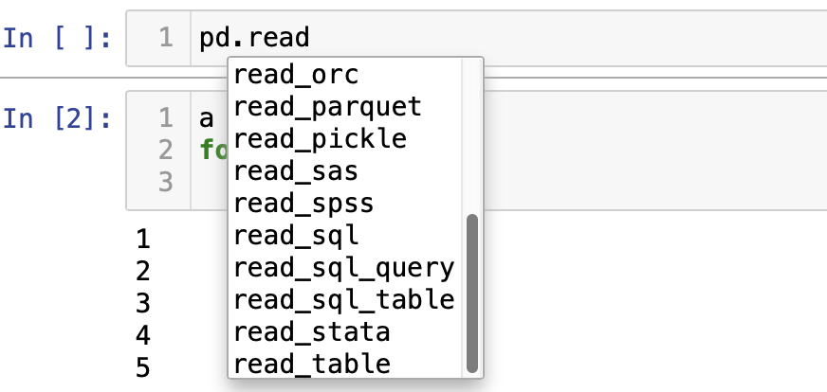
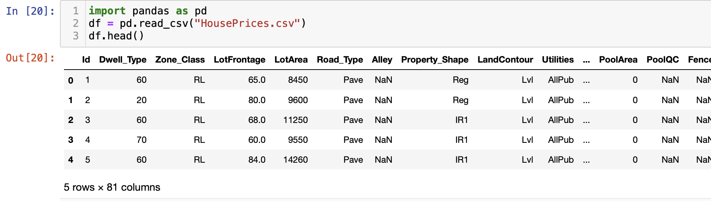
How to read data in Pandas?

Slide 13

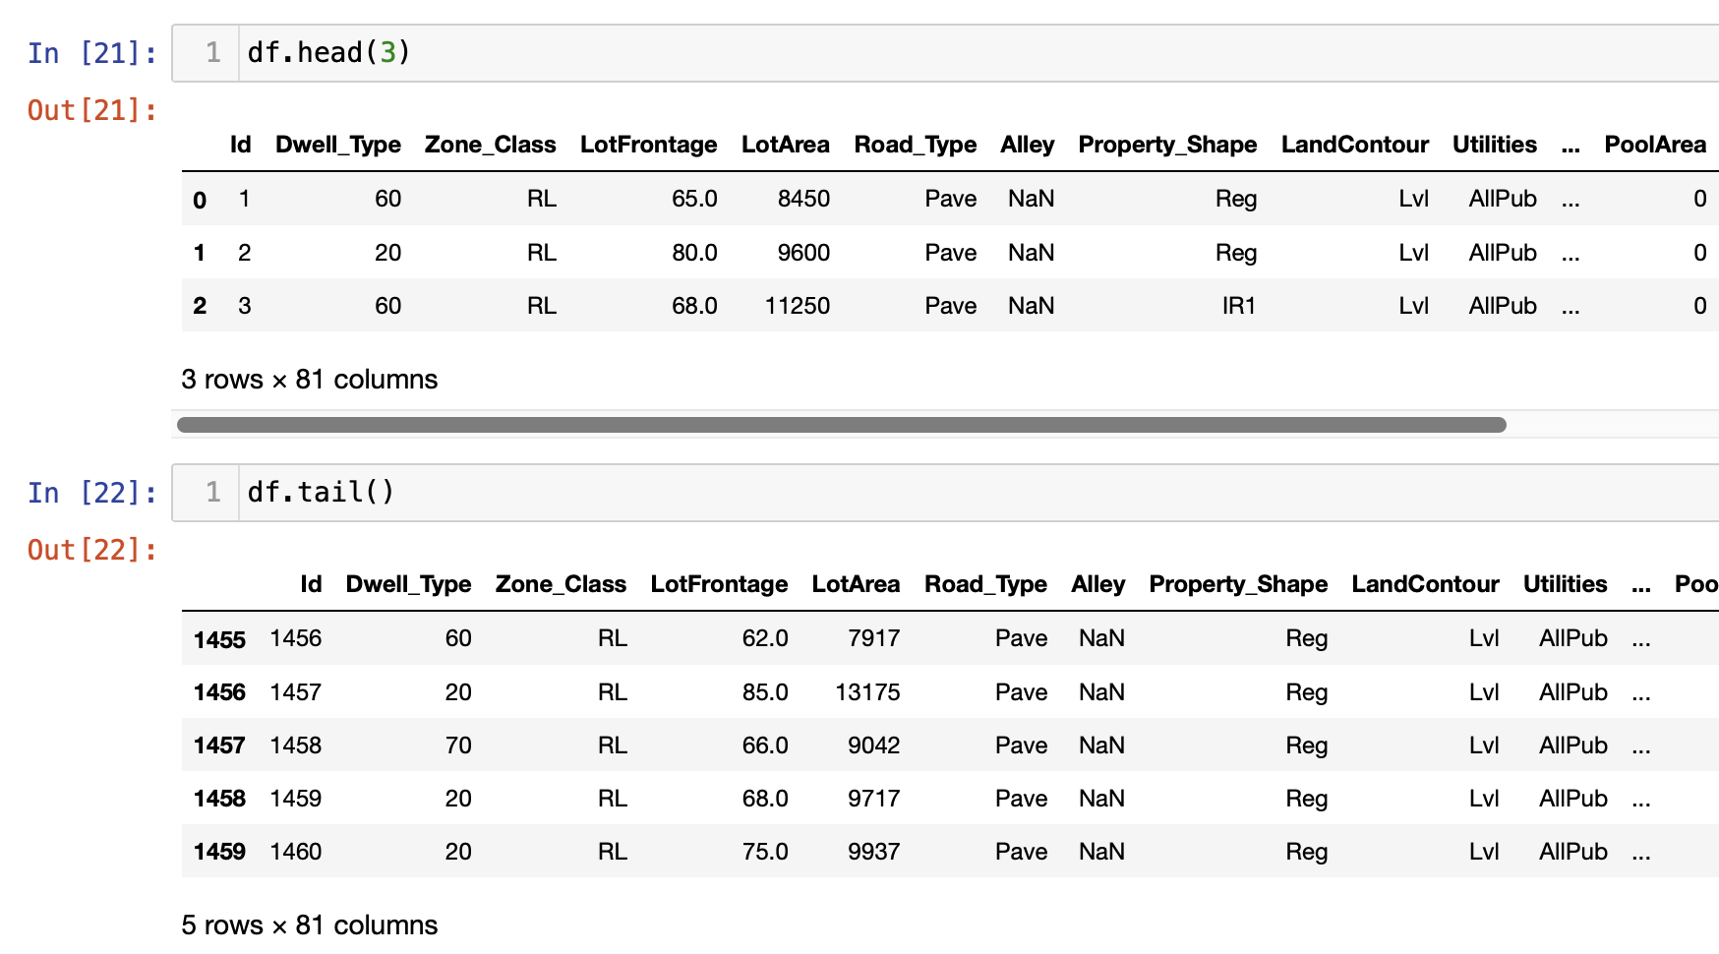
Head and tail in Pandas
To see .head() outputs the first five rows of your DataFrame by default.
the last five rows use .tail() also accepts a number, and in this case we printing the bottom two rows.:

Slide 14
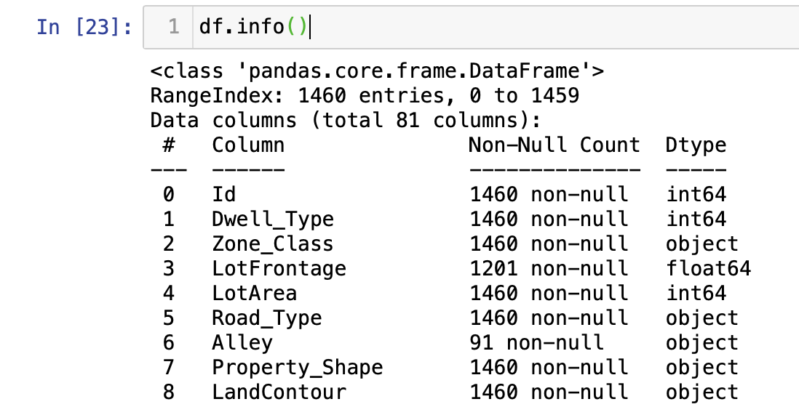
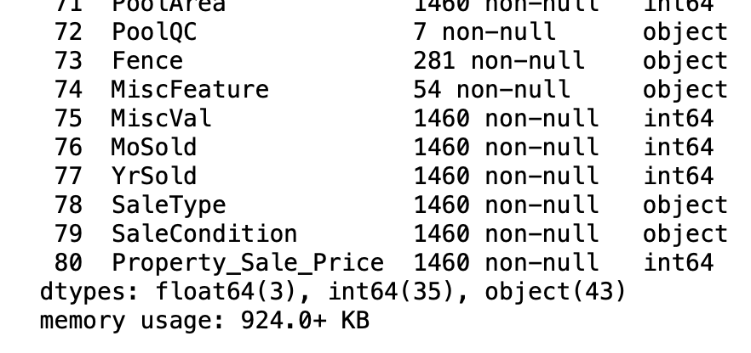

.info() provides the essential details about your dataset, such as the number of rows and columns, the number of non-null values, what type of data is in each column, and how much memory your DataFrame is using.
Getting info about your data

Slide 15
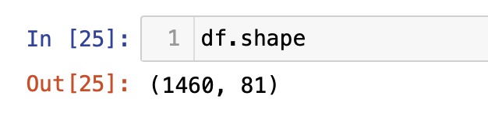
Another fast and useful attribute is .shape, which outputs just a tuple of (rows, columns):
Note that .shape has no parentheses and is a simple tuple of format (rows, columns). So, we have 1460 rows and 81 columns in our movies DataFrame.

Slide 16
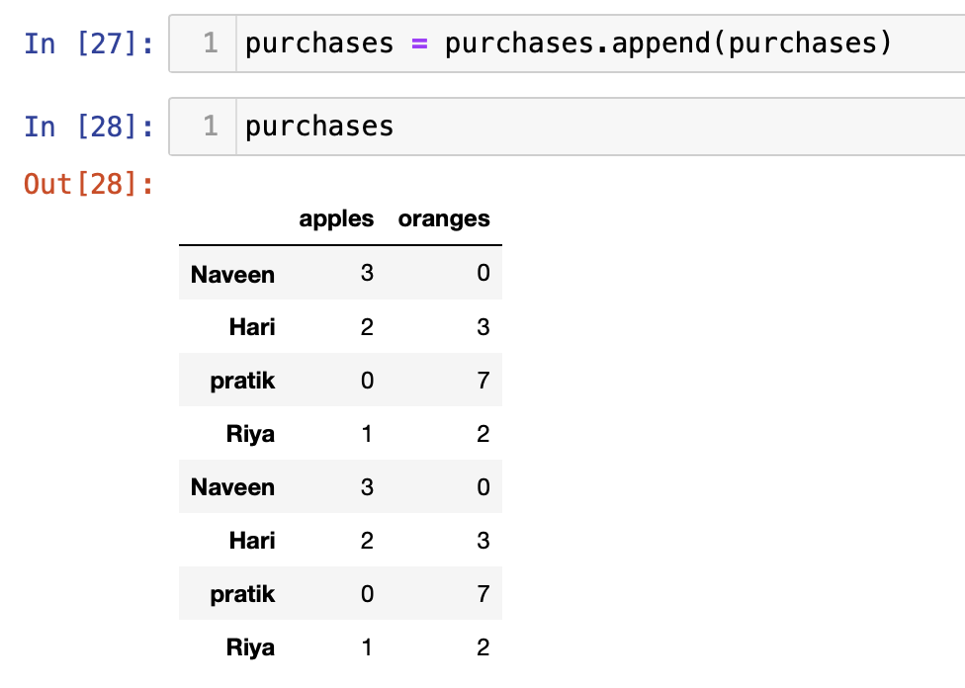
Append:
Using append() will return a copy without affecting the original DataFrame.

Slide 17
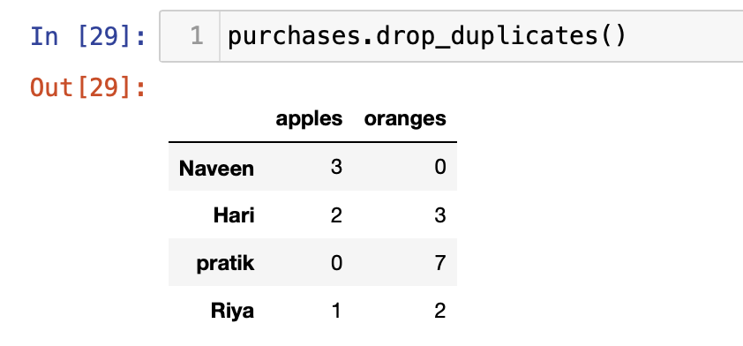
Drop_duplicates:
The drop_duplicates() method will also return a copy of your DataFrame, but this time with duplicates removed.
Another important argument for drop_duplicates() is kept, which has three possible options:
first: (default) Drop duplicates except for the first occurrence.
last: Drop duplicates except for the last occurrence.
False: Drop all duplicates.

Slide 18
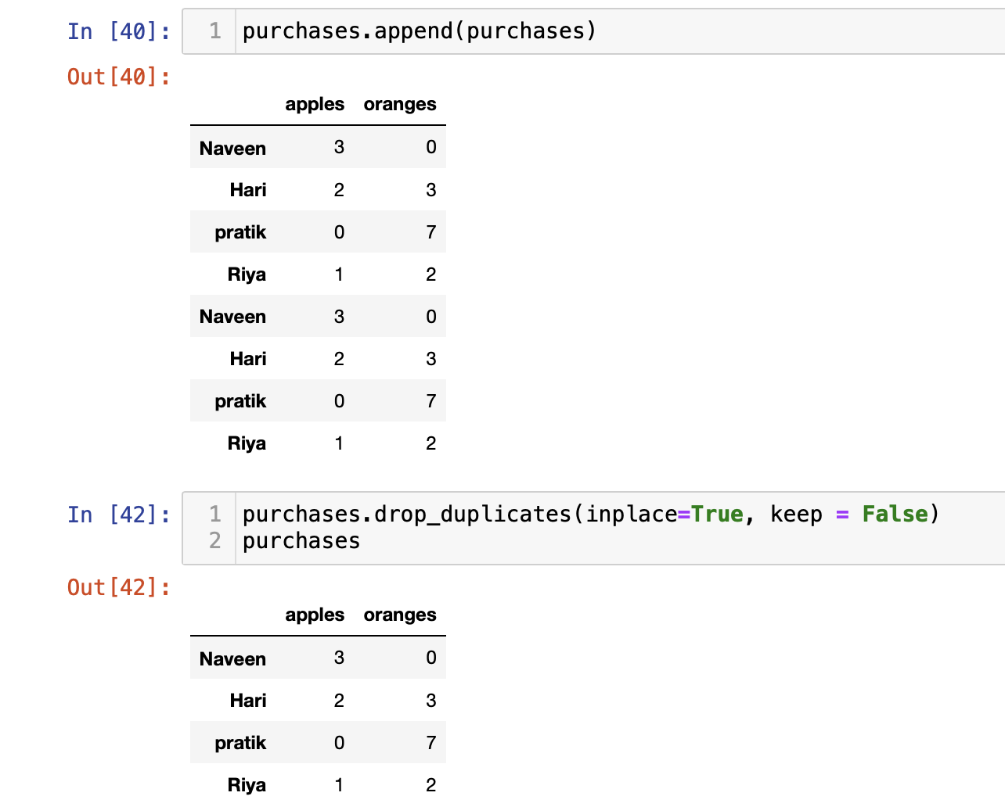
Inplace
Pandas has the inplace keyword argument on many of its methods. Using inplace=True will modify the DataFrame object in place:

Slide 19
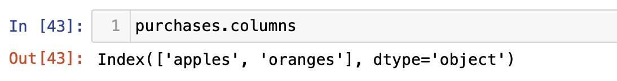
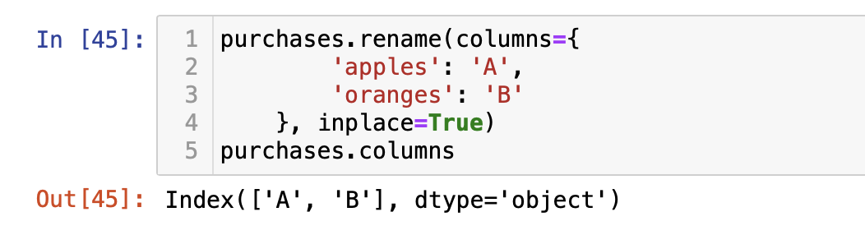
Column cleanup
Many times datasets will have verbose column names with symbols, upper and lowercase words, spaces, and typos. To make selecting data by column name easier we can spend a little time cleaning up their names.

Slide 20
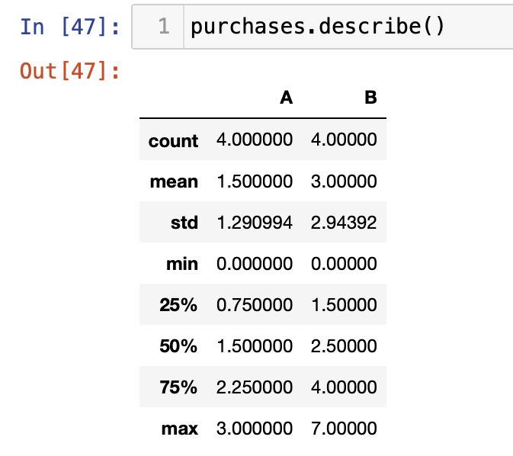
Understanding your variables
Using describe() on an entire DataFrame we can get a summary of the distribution of continuous variables:

Slide 21
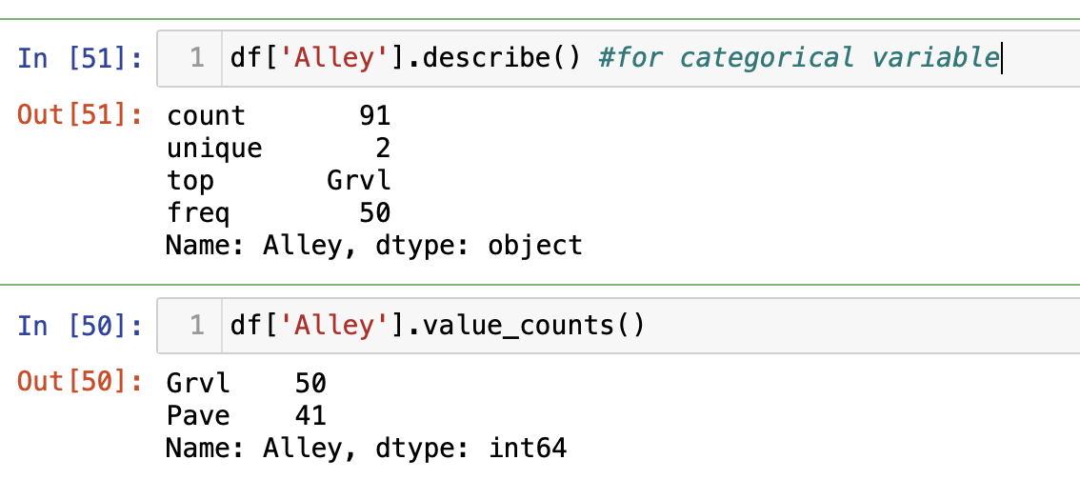
Value_counts
.value_counts() can tell us the frequency of all values in a column:

Slide 22
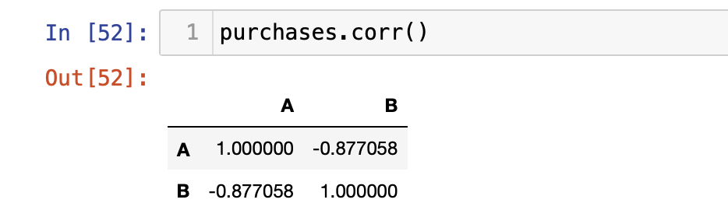
Relationships between continuous variables
By using the correlation method .corr() we can generate the relationship between each continuous variable:

Slide 23
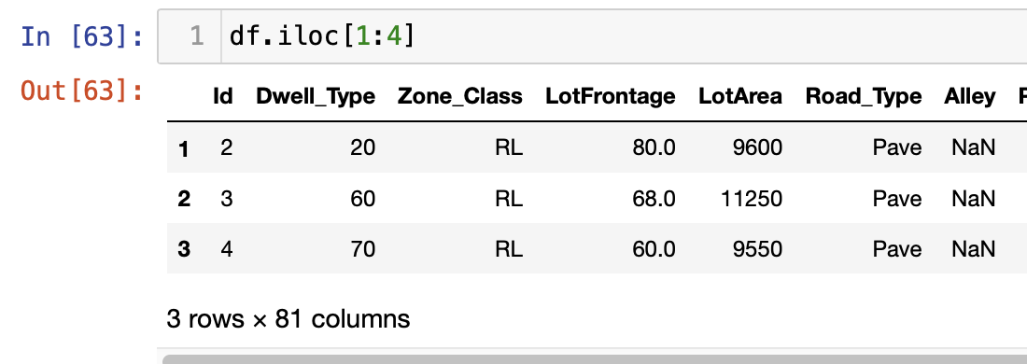
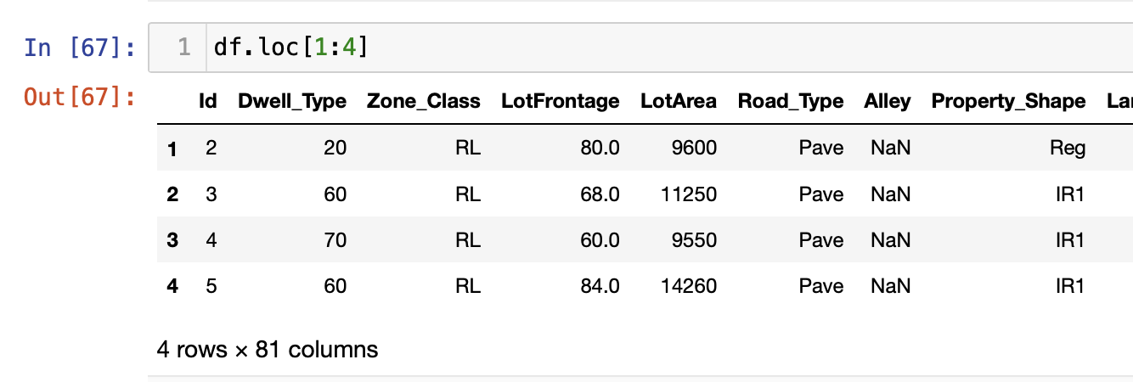
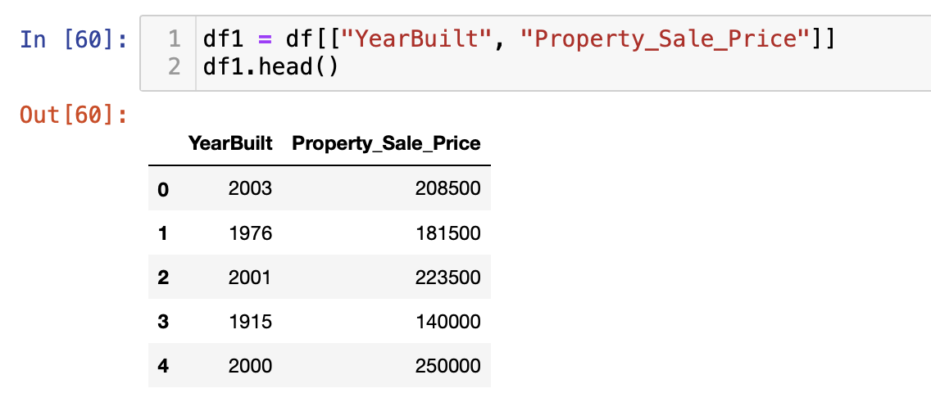
Slicing
By column
using square brackets like this:
By rows
For rows, we have two options:
.loc - locates by name
.iloc- locates by numerical index

Slide 24
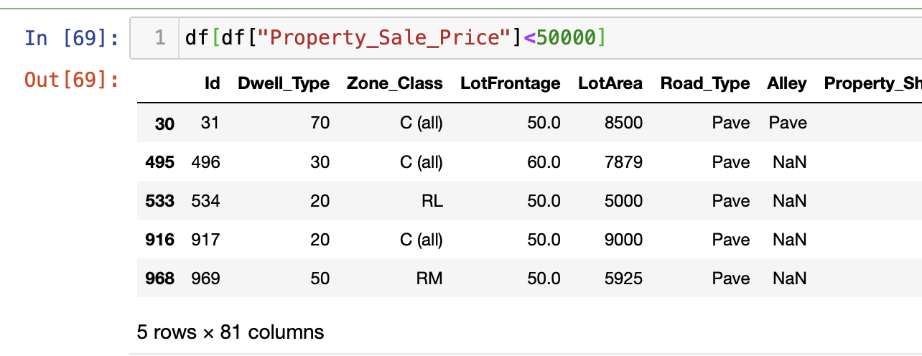
Conditional selections

Slide 25

Plotting:
Another great thing about pandas is that it integrates with Matplotlib, so you get the ability to plot directly off DataFrames and Series. To get started we need to import Matplotlib (pip install matplotlib):
import matplotlib.pyplot as plt
plt.rcParams.update({'font.size': 20, 'figure.figsize': (10, 8)})
# set font and plot size to be larger

Slide 26

Various types of Plot:
For categorical variables:
Bar Charts
Boxplots.
For continuous variables:
Histograms
Scatterplots
Line graphs
Boxplots.

Slide 27
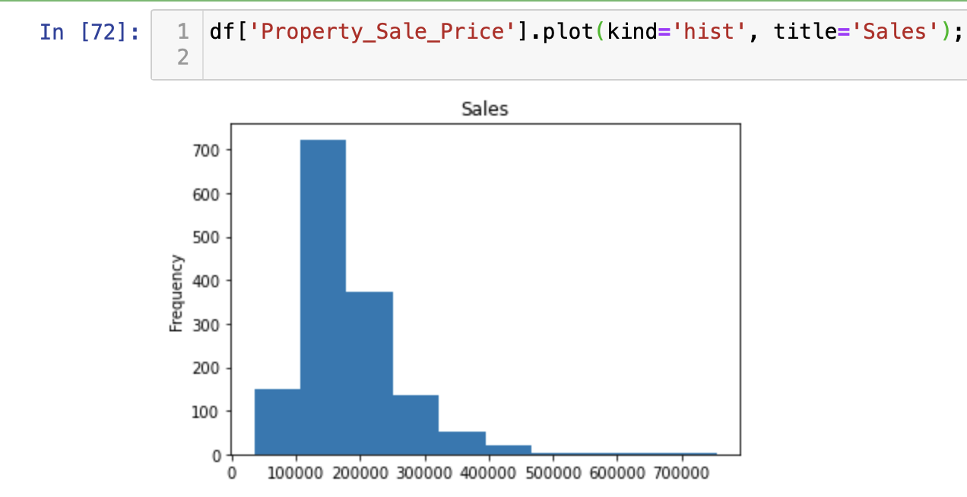
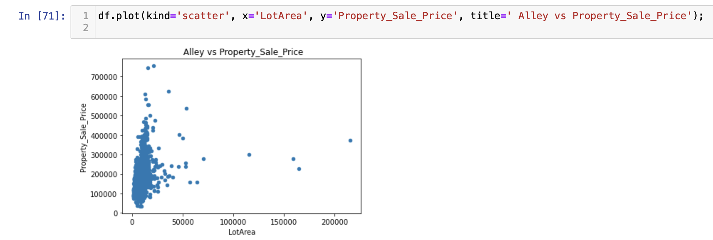
Scatterplot and Histogram

Slide 28
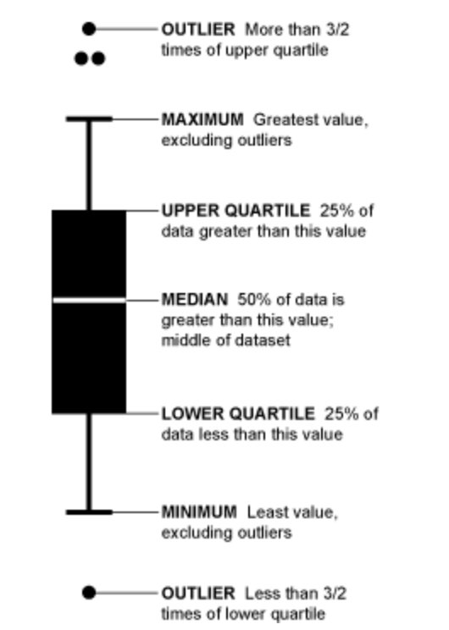
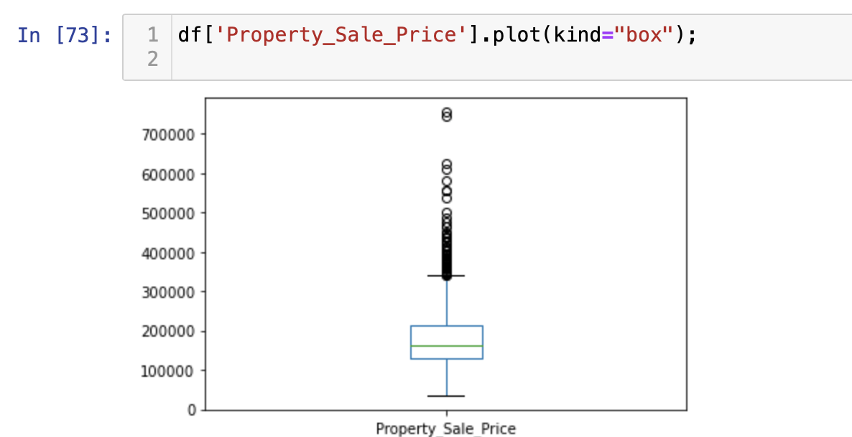
BOX PLOT

